Slide 1
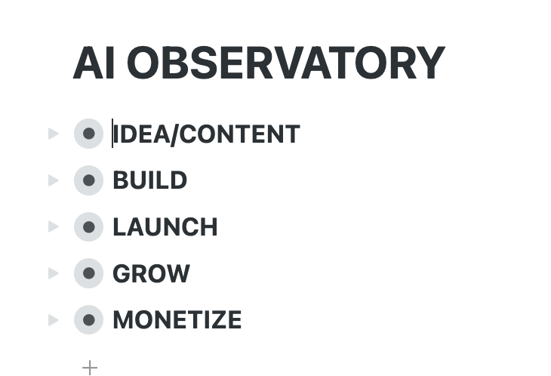
MVP – we don’t go too crazy ☺
Ideas Lab 2025 (March 3-4)
Sky is the limit

Slide 2
Goal of the meeting:
- Agree on the 3 profile types
- Validate AI/world page
- Discuss the 3 sections per profile for the 2 others
- Wild killer features?
- Quick demo by Carlos on digital democracy
Next:
- We build and we iterate until MVP at the ideas lab
- Do we want to show something at CEPS <> Google in Nov?

Slide 3
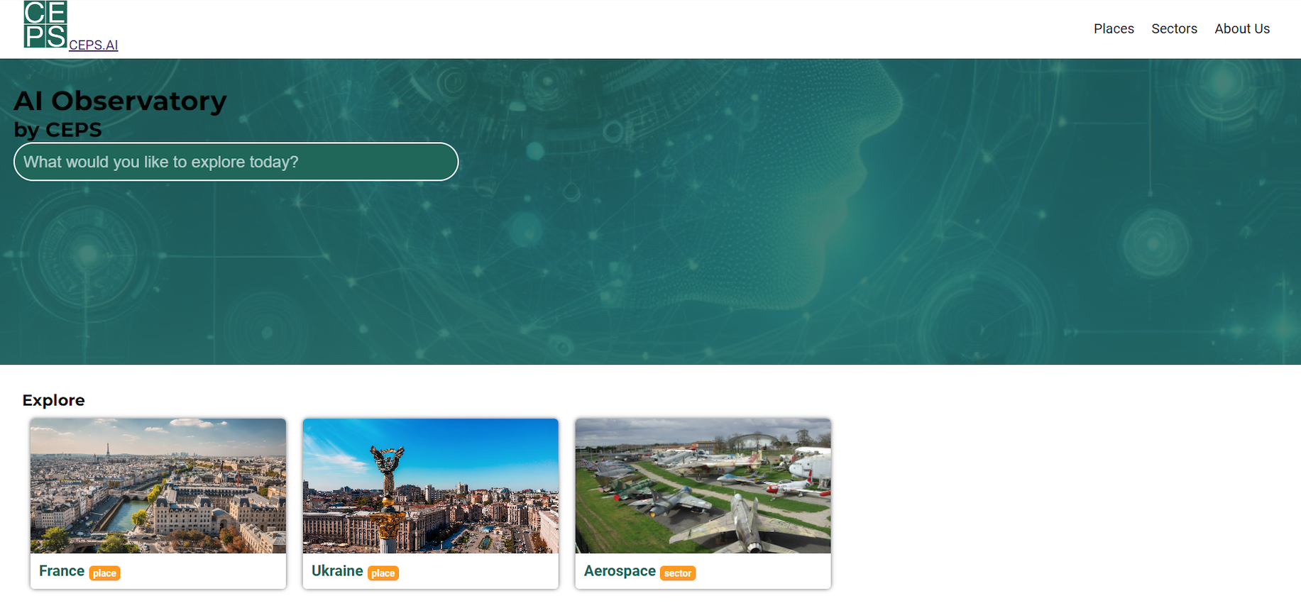
HOMEPAGE
ceps.ai
World
Watching the world transforms with AI

Slide 4
WORLD PROFILE
ceps.ai/world
World
China is the leading country in AI. But France is rising and will lead by 2030.
Hero section of the world of AI
KPI1
KPI2
KPI3

Slide 5
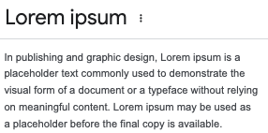
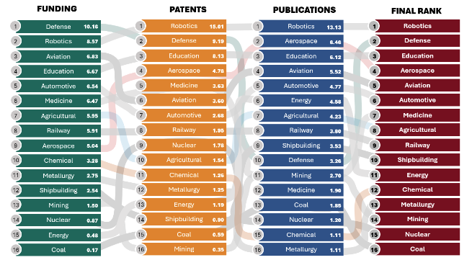
Ranking of PLACES
ceps.ai/world #section1
COUNTRIES
CITIES
REGIONS
France, US, China…
Notes:
PATENTS

Slide 6
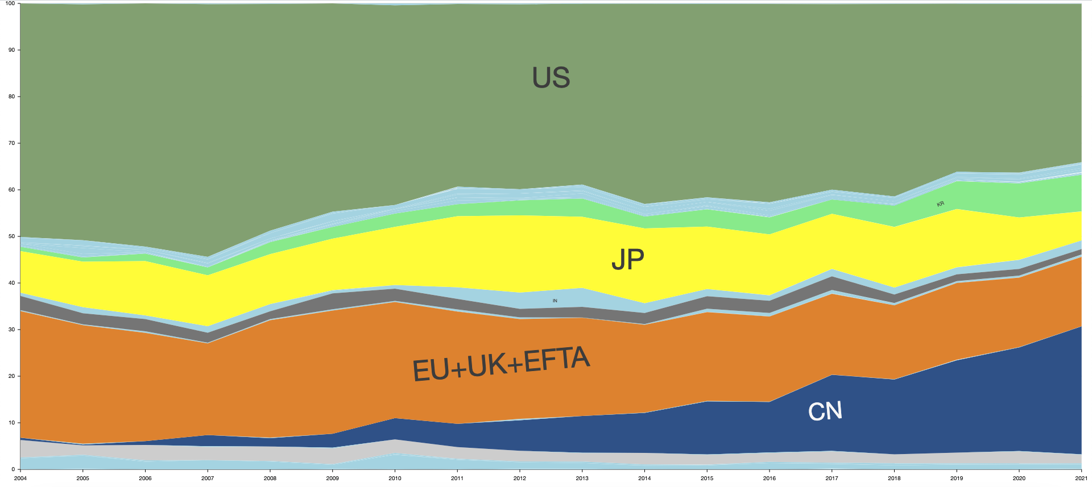
AI velocity of PLACES
ceps.ai/world#section2
PATENTS
PUBLICATIONS
FUNDING
ALL
Notes:
PATENTS

Slide 7
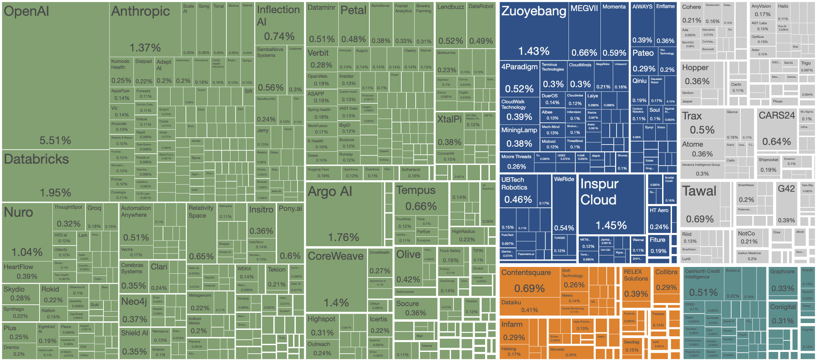
Global AI ecosystem
ceps.ai/world#section3
PATENTS
PUBLICATIONS
FUNDING
ALL
Notes:
PATENTS

Slide 8
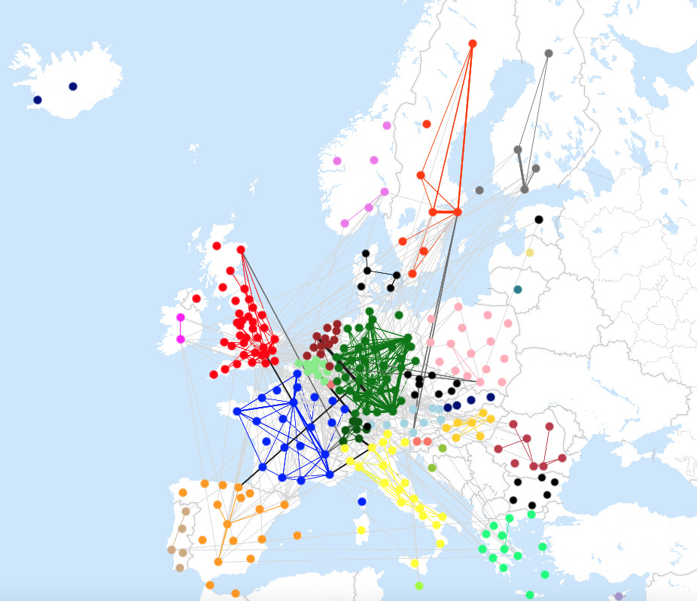
Global AI ecosystem – links
ceps.ai/world#section3
COUNTRIES
CITIES
REGIONS
PATENTS
PUBLICATIONS
FUNDING
ALL
Notes:
PATENTS

Slide 9
Ranking of SECTORS
ceps.ai/world #section4
2-digit
3-digit
PRIO
France, US, China…
Notes:
PATENTS

Slide 10
AI velocity of SECTORS
ceps.ai/world#section2
PATENTS
PUBLICATIONS
FUNDING
ALL
Notes:
PATENTS

Slide 11
Global AI ecosystem – parent = sectors
ceps.ai/world#section3
PATENTS
PUBLICATIONS
FUNDING
ALL
Notes:
PATENTS

Slide 12
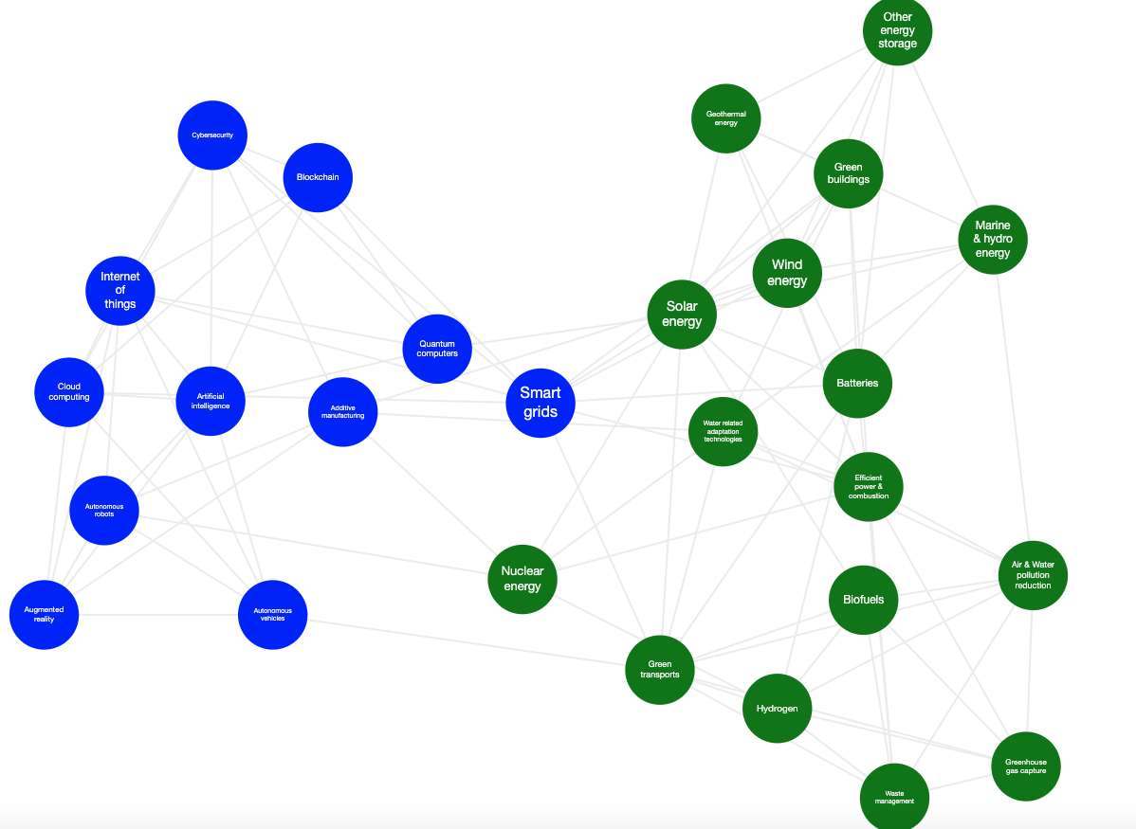
Global AI ecosystem – links
ceps.ai/world#section3
PATENTS
PUBLICATIONS
FUNDING
ALL
Notes:
PATENTS

Slide 13
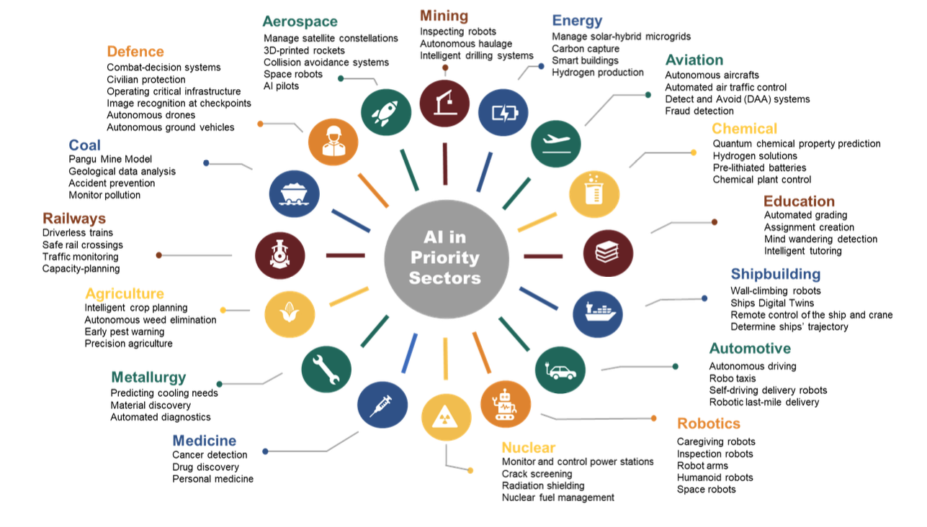
Use cases of AI
ceps.ai/world#section3
SELECT SECTORS
Notes:
PATENTS

Slide 14
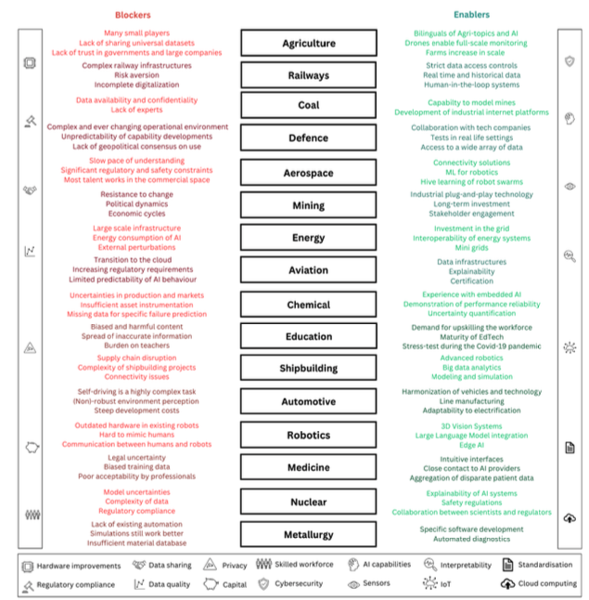
Blockers and enablers
ceps.ai/world#section3
SELECT SECTORS
Notes:
PATENTS

Slide 15
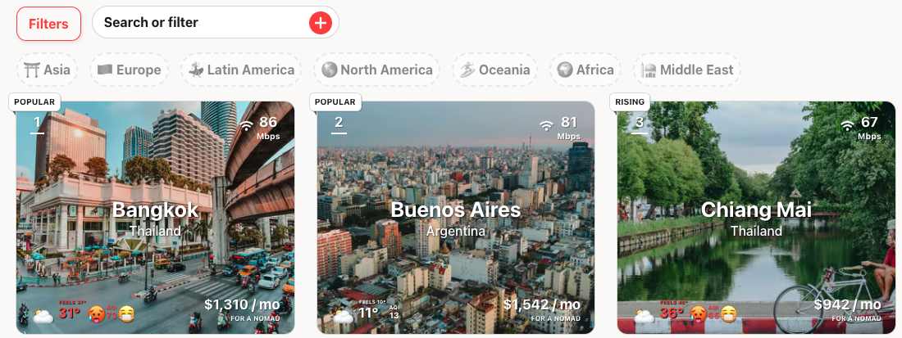
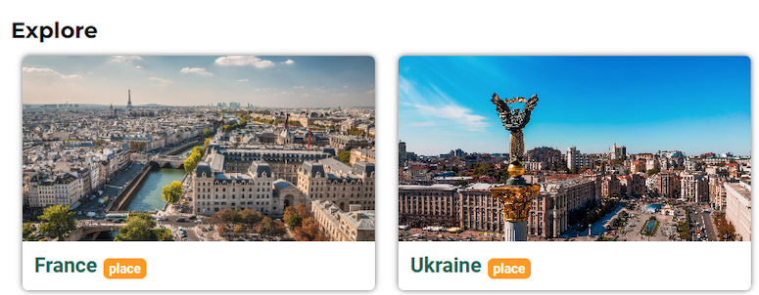
WORLD PROFILE
ceps.ai/world
World
China is the leading country in AI. But France is rising and will lead by 2030.
Hero section of the world of AI
KPI1
KPI2
KPI3

Slide 16
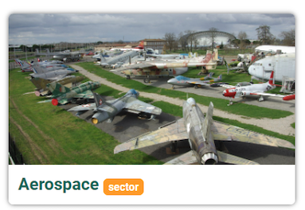
WORLD PROFILE
ceps.ai/world
World
China is the leading country in AI. But France is rising and will lead by 2030.
Hero section of the world of AI
KPI1
KPI2
KPI3

Slide 18
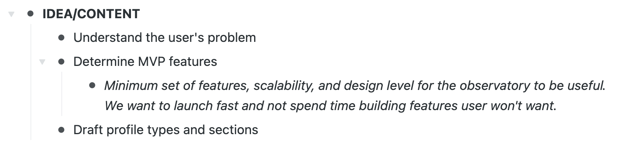
CEPS TEAM
Led by Andrea, Cinzia, Laura, PA

Slide 19
CEPS AI OBSERVATORY (PAGE PROFILES)
PLACE
PLACE
PLACE
Jobs
Regulation
Industry
PLACE
Compute infra, data centers and cloud providers
Application & tasks
Model
Product
PLACE
PLACE
PLACE
PLACE
People (inventors)
Company
Investors
Notes:
Add

Slide 20
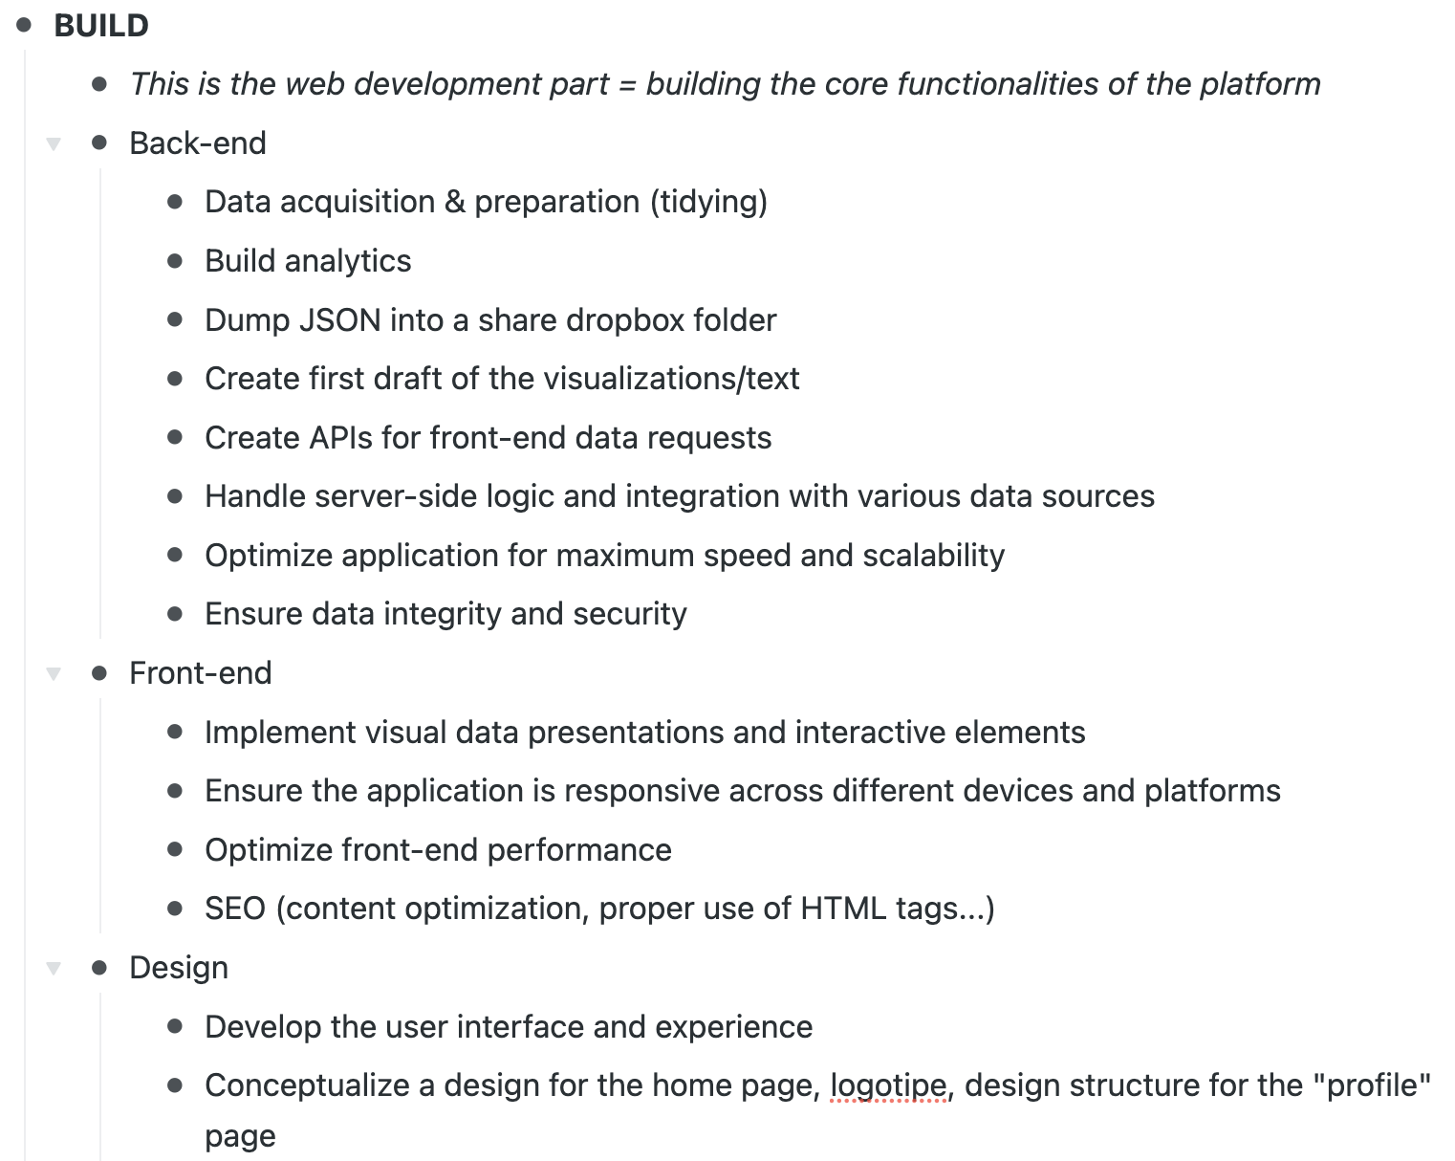
CEPS data science team (PA, Robert & Olesya)
Goal is to agree on basic structure and start a dev version of the obs asap (prod mode)

Slide 21
Conce team (Carlos + RA)

Slide 22
Design team (Danae)

Slide 23
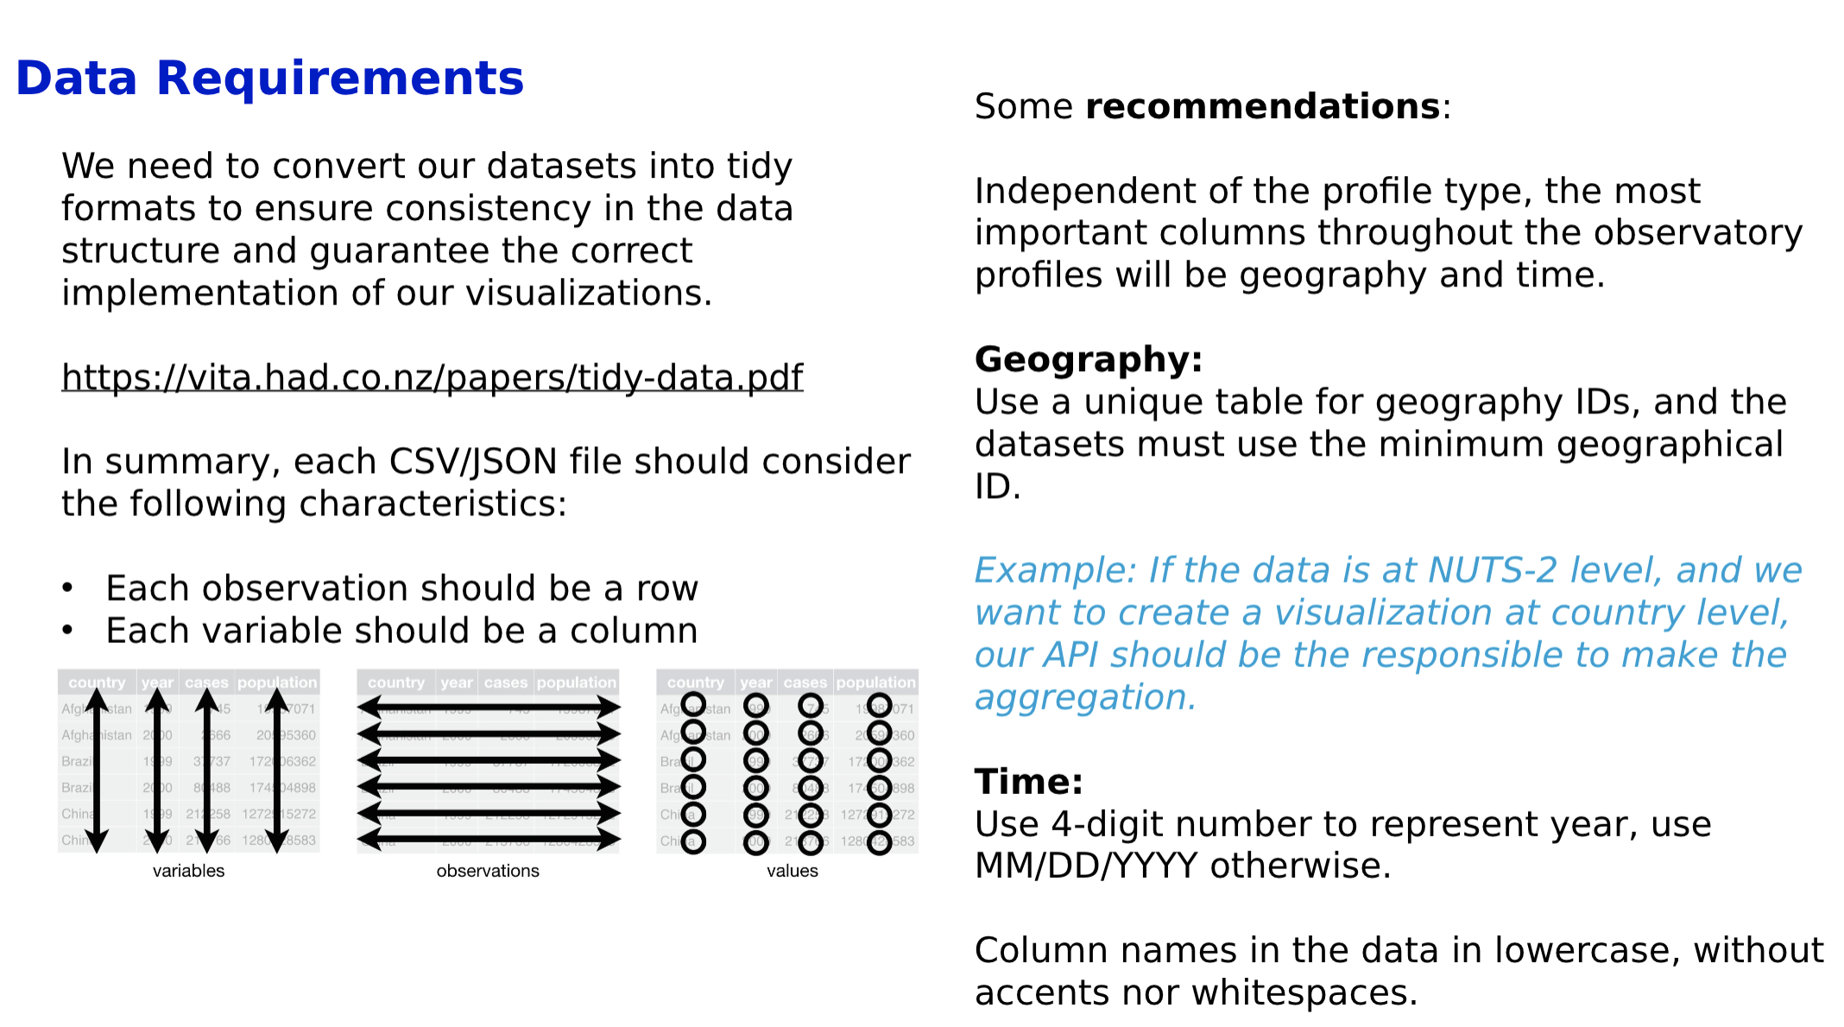
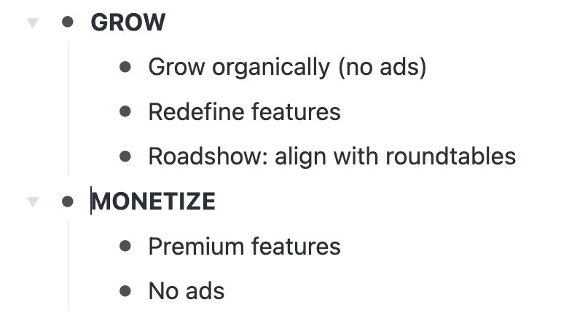

Slide 24
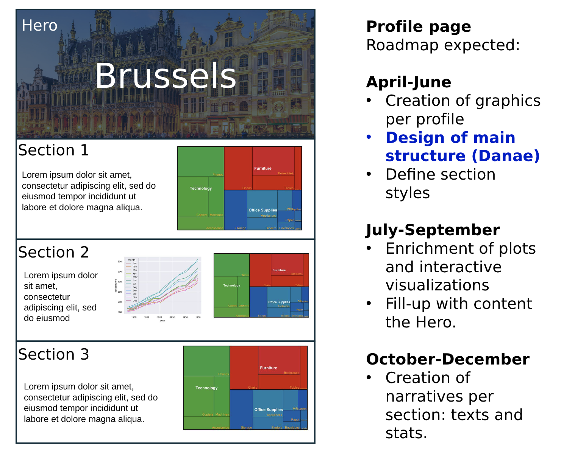

Slide 25
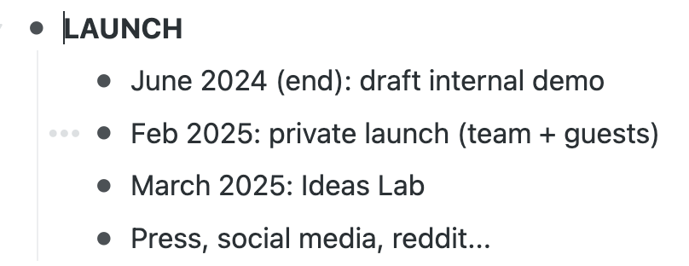

Slide 26
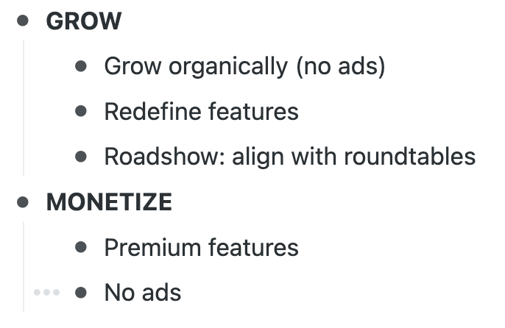

Slide 27
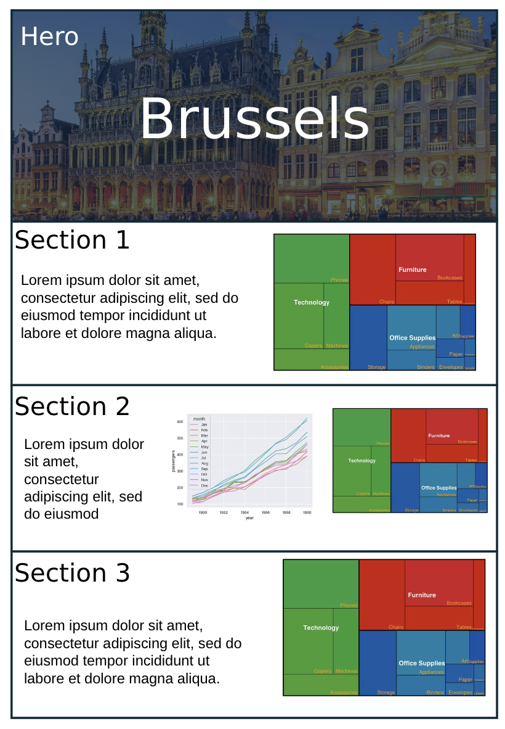
City name
KPIs
Text (seo) about section + links
Start-up ecosystem (+ patents + public)
Growth of AI
A map of where AI researchers come from
ranking

